Slide 1

Cowichan Valley Regional District | 2016
CLIMATE CHANGE due to Global Warming
Hamid Hatami, Ph.D., P.Eng
Engineering Department

Slide 2
Overview
Climate Change due to Global Warming
What Causes the Earth Temperature to increase?
How the Earth Temperature Increases
The impacts of Climate Change
In Canada
In BC
Response to Climate Change

Slide 3
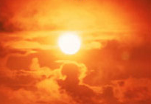
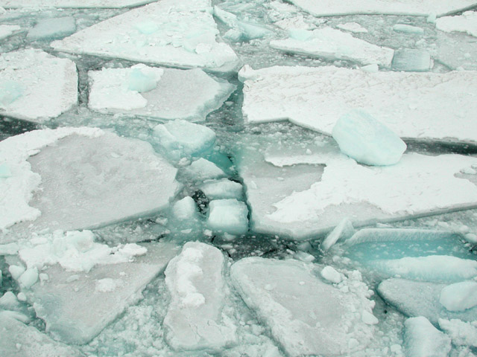
Climate Change due to Global Warming
What is Global Warming?
Increase in the Earth’s Temperature as the result of the increase in Greenhouse Gases (GHGs).

Slide 4
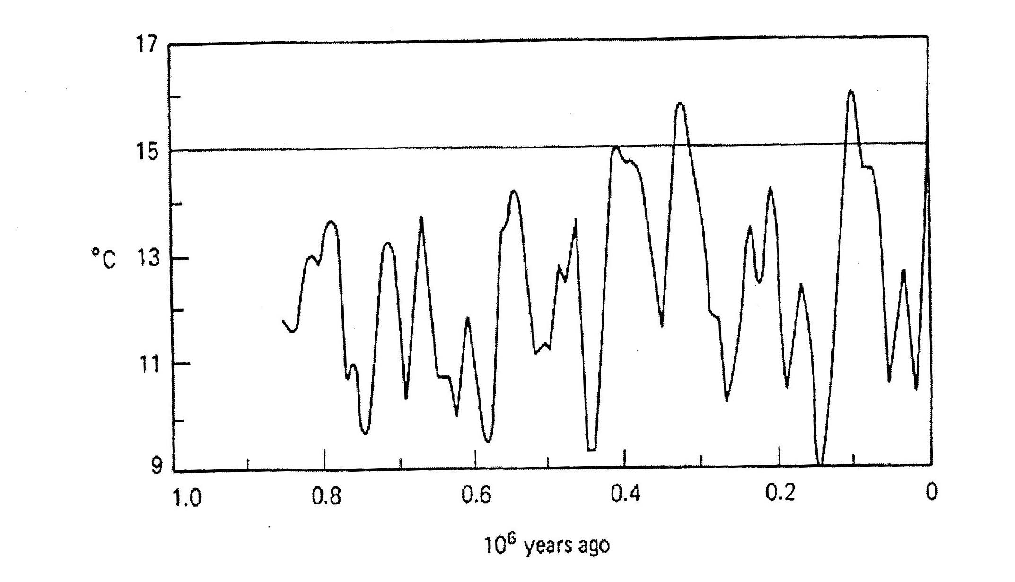
Historical Global Temperature Fluctuations
Northern Hemisphere Mid-Latitude Air Temperatures during the past one million years (Masters, 1991)
Historically global temperatures have fluctuated with a primary cycle of 100,000 years and secondary cycles ranging from 20,000 to 40,000 years

Slide 5
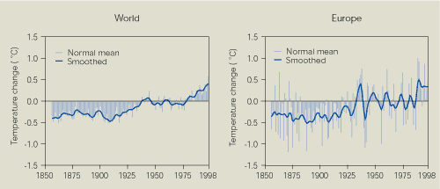
Increase in Earth Temperature
Earth’s Surface temperature for the period of 1850 to 1998.
Source: Climate Research Unit (CRU), 1998
Note: Temperature plotted as the variation from 1860-1990 mean. The bars show the annual average as the variation from 1960-1990 mean and the line the 10-year smoothed trend

Slide 6
What Causes the Temperature to Increase?
Are these changes just natural fluctuations?
This Question has been the subject of some intense scientific debate
The simple answer is GREENHOUSE GASES (GHGs) and their effects

Slide 7
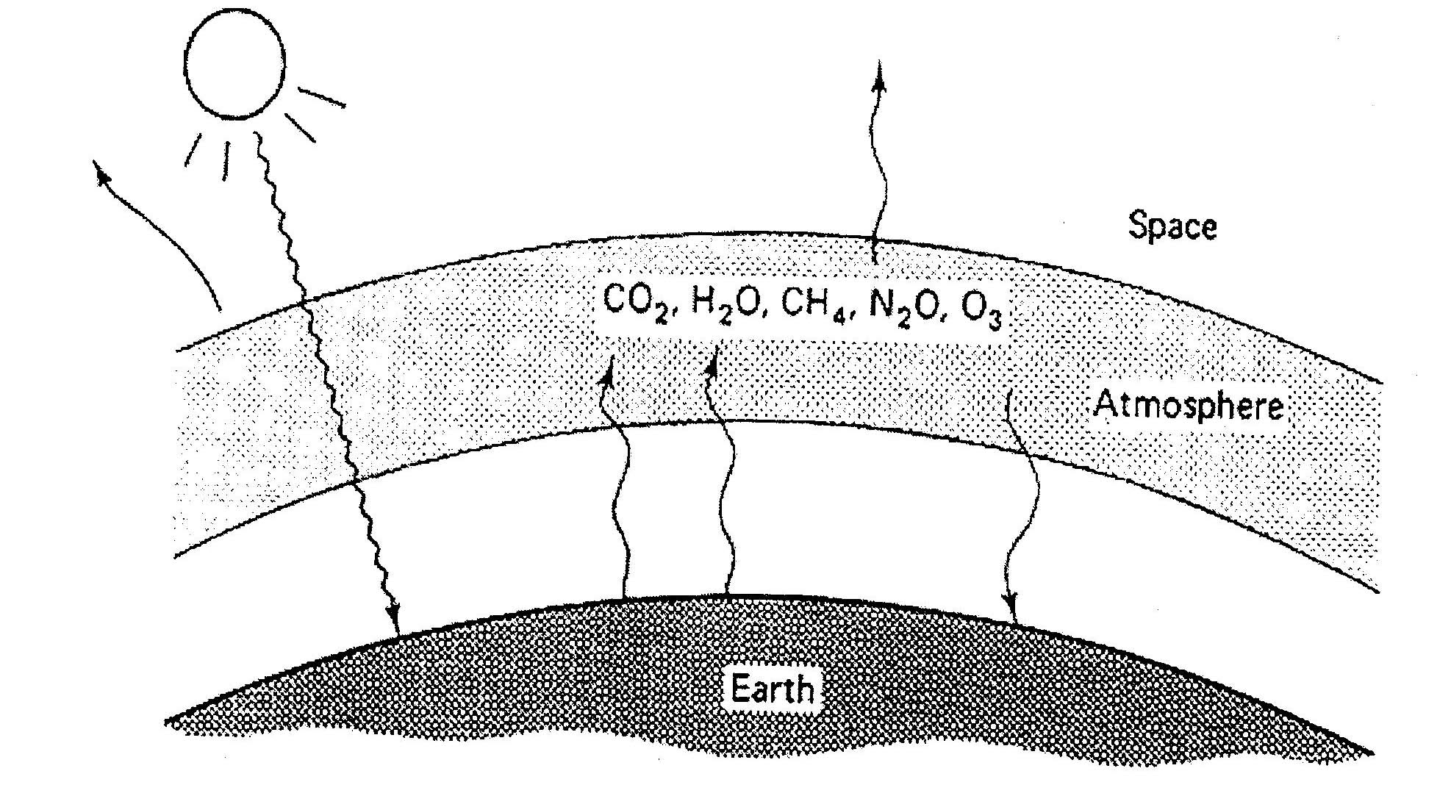
Greenhouse Gases & their effects on temperature increase
The Earth’s atmosphere contains heat-trapping gases such as Carbon Dioxide (CO2), Methane (CH4), Nitrous Oxide (N2O), and Water Vapour (H2O)
Without Greenhouse effect the earth’s temperature would be 33^{oC} colder than it is.

Slide 8
The Impact of Climate Change
Global warming models have been developed to predict the impacts of increased GHG on global mean temperatures and climate.
Current estimates suggest if current trends continue, the global mean surface temperature will increase between 1^{OC} and 4.5^{OC} by year 2100.
Such an increase will affect:
Human Health
Water Resources
Forests
Non-Tidal Wetlands
Coastal Zones
Agriculture
Fisheries
Wildlife

Slide 9
The Impact of Climate Change in Canada
In General
Temperature
Precipitation
On the Ground
Frozen Ground
Sea/Lake Ice
Streamflow & Lake Water Levels
Drought
Cyclonic Storms

Slide 10
Costly Weather Events in Canada Excluding Drought – Some Examples
Event and Date | Region | Estimated Costs
Ice Storm, 1998 | Ontario, Quebec | $5.4 billion
Saguenay flood, 1996 | Quebec | $1.7 billion
Calgary Hailstorm, 1991 | Prairies | $884 million
Red River flood, 1997 | Prairies | $817 million
Toronto Extreme Rain, 2005 | Ontario | >$500 million
May 2016 Fort McMurray Wildfires | Alberta | $3.58 billion
June 2013 Southern Alberta Floods | Alberta | $1.72 billion
July 2013 Toronto Flood | Ontario | $943 million
August 2005 Toronto Flood | Ontario | $590 million

Slide 11
The Impact of Climate Change in Province of BC
Temperature – climate projections suggest the climate in BC will continue to change during 21st century.
Prediction of warming of 1.5-4^{O}C.
Sea level may rise by 88 cm in certain parts of the coast.
Salmon migration and spawning pattern are likely to change.
Warmer springs → will promote earlier break up of lake and river ice that results in river hydrology change.
Warmer summer → increase in the rates of evaporation and plants transpiration → reduced moisture, increased soil erosion, increase demand for irrigation, loss of wetlands, slower vegetation growth, forest fires, conversion of forest to grassland.
Declines in Groundwater supplies and water quantity in some areas.
Increase temperature in freshwater ecosystem, creating stressful conditions for some fish species.
Summer heat waves happening more frequently and will increase heat-related illnesses.

Slide 12
The Impact of Climate Change in Province of BC
Precipitation –
Increased fall and winter precipitation
Decrease summer precipitation

Slide 13
The Impact of Climate Change in Province of BC
Glacial Flows –
significant impacts on freshwater and estuarine ecosystem, aquatic species, and human activities.
Sea Level Rise –
impacts on wetlands, beaches, aboriginal heritage sites, sensitive coastal ecosystems, private properties, straining drainage and sewage systems and salt water intrusion into groundwater aquifers.

Slide 14
The Impact of Climate Change in Province of BC
Agriculture –
An increase in available heat energy may allow farmers to succeed in introducing new varieties of crops.
Changes in hydrological systems combined with warmer temperatures and greater evapotranspiration may mean less available soil moisture in some regions as well as increased demand for irrigation.
Warmer temperatures mean that new insect pest species are able to move into the region.

Slide 15
The Impact of Climate Change in Province of BC
Water Shortage –
Smaller glaciers and decreased snow pack, changes to the amount and timing of precipitation, and prolonged drought will place further limits on water supply during times of peak demand.
Increase in competition amongst water users.
Fisheries –
Fisheries will be impacted by increased competition for water usage (irrigation, municipal water supply systems, and hydroelectric power generation).
Freshwater and saltwater environments of pacific salmon will be vulnerable to climate change.

Slide 16
The Impact of Climate Change in Province of BC
Infrastructure –
Increasing intensity and frequency of extreme weather and related natural hazards will impact critical infrastructure, including transportation networks, port facilities, electricity & telecommunications.
Other -
Impacts to quality of life.
Impacts to economic development and redeployment of limited resources.

Slide 17
Response To Climate Change
Slow down climate change by reducing
emissions of carbon dioxide, methane and other greenhouse gases from municipal sources and from carbon energy consumption of citizens
Adapt infrastructure, economy, social
support services, energy sources and lifestyle to climate change that has already occurred and change that is now inevitable

Slide 18
CONCLUSIONS
Global industrialization & Population increase have caused an increase in the atmospheric concentrations of GHG – 0.5%/year for CO2 and 0.8%/year for CH4.
Increase in GHG concentration contributed to global warming – if the same trends continue the earth’s mean surface temperature may show an increase of 1^{oC} to 4.5^{oC} by 2100.
Substantial changes in precipitation pattern and the frequency and severity of floods and draughts.
Lake Levels decline - moisture evaporation causing reduction in the run-off in rivers and lake levels
Diminishing ground water recharge – increase the need for more lake-based water and may be an increase in water distribution network
Water Pollution.

